Slide 1
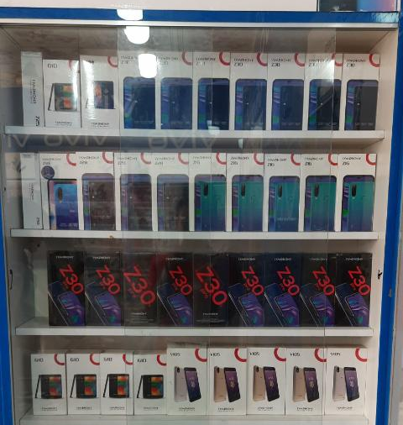
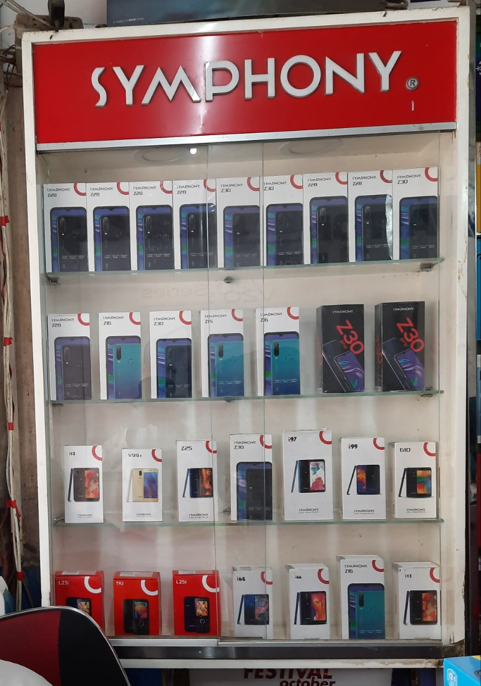
Dummy Box
A POP/POSM look alike product packaging to promote that specific product
Execution Guideline:
Must be placed in shelf
Can be placed 2/4 pcs together in most visible part of shelf
Can be attached with the help of tape
Mostly for potential retails where specific model can be placed

